Slide 1
Harman/GWW Project Kickoff Meeting April 2017

Slide 2
Agenda
Overall silicon and SW release schedule
APL Soc Introduction
AVM and MOD
Linux BSP
IPS system
Supporting model

Slide 3
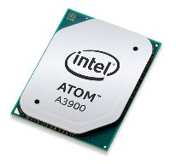
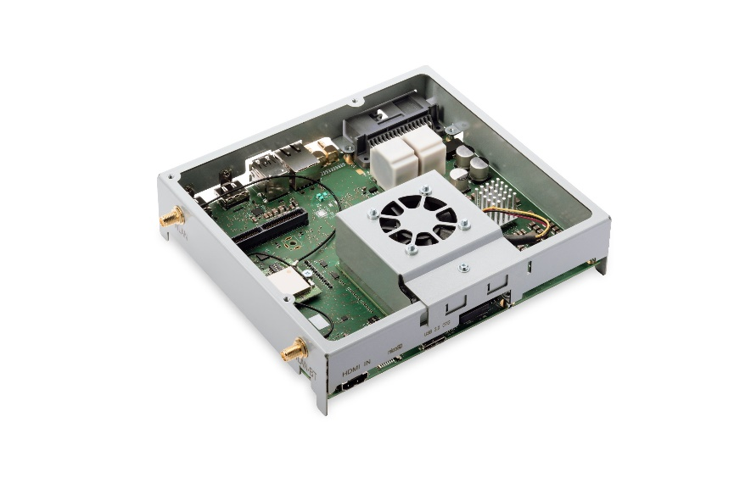
APL-I SOC & Gordon Ridge MRB Schedule Update As of WW15’17
SOC | Availability
B2 (QS) | Available Now
D0 (PRQ) | WW18 2017
AEC-Q100 | WW42 2017
MRB Dev Kit (Module Reference Board) | Availability
B Sample | No Supply
C Sample | Available Now
D Sample | WW19 2017
Images not to scale!
All dates are the start of shipments, please contact your Intel Representative for exact dates on your order

Slide 4
Gordon Peak Yocto Release Schedule
GP1.0.1 Release W50/5
GP1.0.2 Release W15/5
GP1.0.3 Release W29/5
Today
January
March
May
July
September
November
Start W50/5
Finish W50/5
Yocto BSP based on Linux kernel 4.1.27
Some incremental engineering releases will be provided before GP1.0.3
Some new features and driver updates may come in before GP1.0.3
Releases beyond GP1.0.3 is TBD
Change request process between Intel and Harman to be discussed

Slide 5
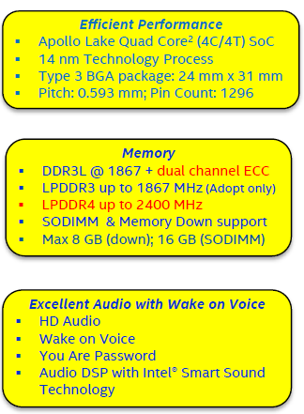
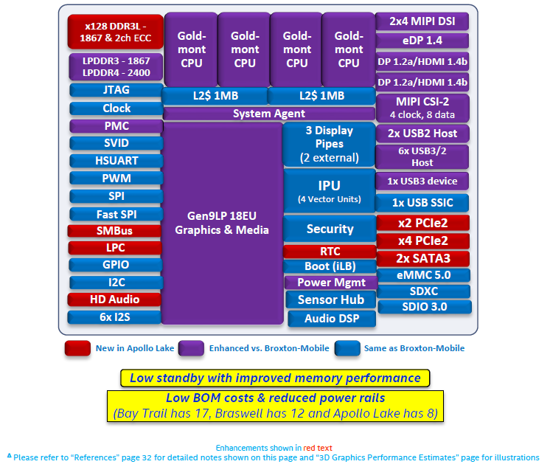
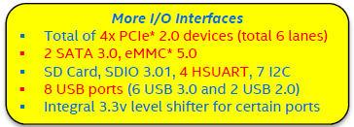
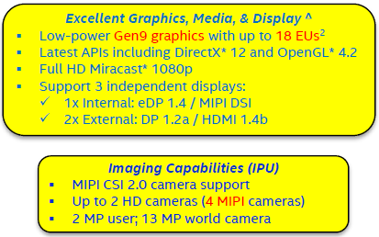
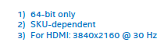
Apollo Lake Platform Feature Enhancements

Slide 6
Intel® Atom™ Automotive Reference Board (formerly Gordon Ridge MRB) HW Block Diagram
System
SPI Flash
8MB
MASS STORAGE
2x SATA SSD/BD
Intel Atom x5/x7 module
(aka Gordon Ridge BMP)
VIDEO OUT1/2
2x TMDS / DDC -> HDMI
HDMI DISPLAY 1/2
SD-CARD
MASS STORAGE
1x SD-CARD Slot
VIDEO OUT1/2
2x TMDS / DDC -> HDMI
HDMI DISPLAY 1/2
Managed NAND
16GB
Memory:
Up to 8GB
(4x16Gb)
ANALOG VIDEO IN (1x)
VIDEO IN
ANALOG / DIGITAL
2x 1 CH CVBS -> MIPI-CSI
1x HDMI -> MIPI-CSI
ANALOG VIDEO IN (2x)
VIDEO IN ANALOG
1x 1 CH CVBS -> MIPI-CSI
USB 2.0 (1x)
USB
1x 3.0 HD / 1x 3.0
DIGITAL VIDEO IN (1x)
USB 3.0 (1x)
Apple IPOD
Authentication Chip
Intel Atom
Automotive
Processor
(aka Apollo Lake)
MICROPHONE IN (2x)
Radio
Tuner
Phase Div.
AM/FM
DOUBLE
TUNER
BuiltIn
CODEC
6 CH ADC
12 CH DA
ANALOG AUDIO IN
4 CH In
AUX IN Stereo (1x)
Main Connector
CFB Connector
Main Connector
CFB Connector
ANALOG AUDIO OUT
2 CH OUT
HEADPHONE OUT (1x)
WiFi
HIGH EFF. AMPLIFIER
4 CH Out
BT
WLAN 802.11 a/c
Wireless Connectivity
BT / WiFi Module
SPEAKERS (4x)
BlueTooth 4.0
FM / AM
AM/FM Tuner
Double Tuner
FM / AM
FM / AM
Power Management
PMIC + Peripherals
FM
SYSTEM POWER SUPPLY
MSA ready
Single 3V3 Input
TMC Tuner
Single Tuner
FAN
CPU: Up to 4 CORE @ 2.4GHz
GPU: Up to 18 cores @ 750 MHz
M.2 Connector option
ETHERNET AVB (1Gbps)
Springville i210
= Intel Product
MCU
IO-Processor
= basic functions
CAN HS
CAN Transceiver
1x HS / 1x LS CAN
NAVIGATION SENSORS
Gyro / Acceleration
= options
CAN LS

Slide 7
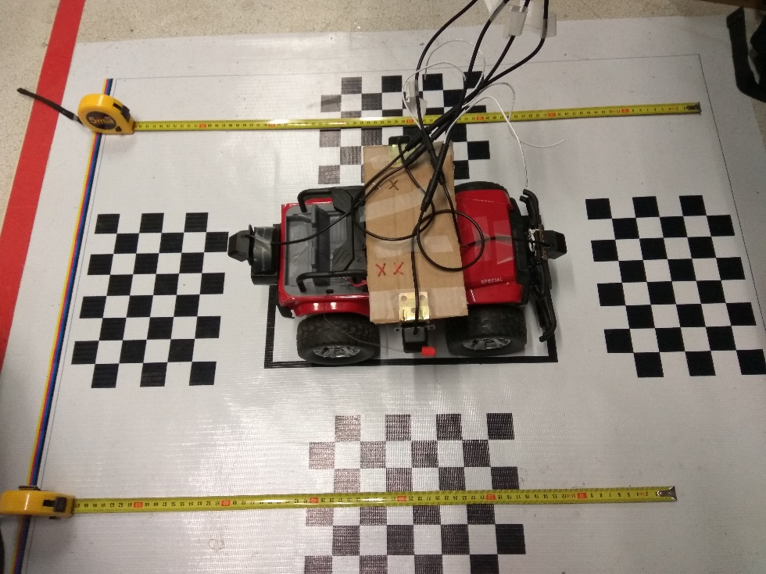
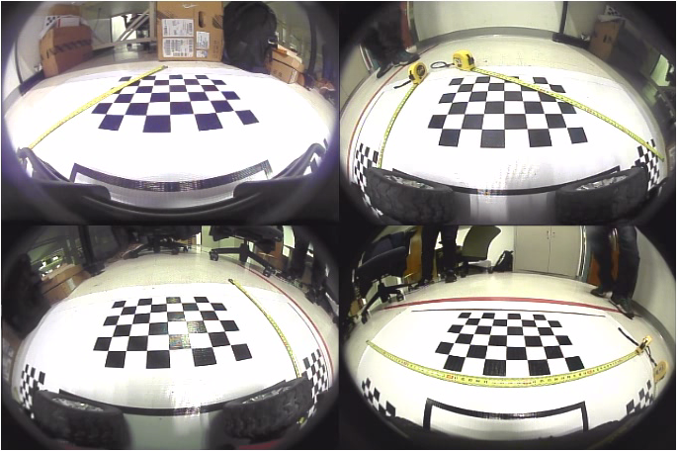

AVM/MOD Product Features
AVM:
Calibration based on crossboards, (one click Calibration)
Auxiliary lines
View change based on steering wheel angle (need data support)
MoD:
Moving object detection under low speed (<5km/hr)
Alert and view change when detection triggered

Slide 8
AVM/MOD Milestone
Harman’s system/GR board ready in Jun end
Harman & Intel’s team start Integration
AVM +MOD Beta on Harman’s system/GR board
(P1 bugs fixed and performance tuning done)
AVM pre-alpha on Ubuntu
(with calibration + auxiliary line + sensor detection for view change)
AVM +MOD Alpha on Harman’s system/GR board
AVM +MOD Gold on Harman’s system/GR board
(Docs + IP plan + test report ready)
AVM Alpha on Yocto/GR MRB
Ww27/Jul 7
Ww31/Aug 4
Ww36/Sep 8
Ww41/Oct 13
Ww44/Nov 3

Slide 9




Gordon Peak Software Platform
Infotainment
Cluster / HUD
ADAS
Other
Key
HMI + Benchmark
HMI + Benchmark
HMI +
Benchmark
HMI +
Benchmark
Intel Ref. OSV for production
3rd Party Reference
Frameworks + MW
KC3.0
MW*
Frameworks + MW
Frameworks + MW
…
…
…
BT
Intel
Product*
3rd Party
Product
AUDIO
PIM
AVB
Android OS + BSP
RTOS + BSP
RTOS + BSP
RTOS SDK & Tools
Yocto & meta-ivi
Intel SDK & Tools
Linux
BSP +
Kernel
Hypervisor
Partner (P1):
SoC
Drivers
Platform
Drivers
SoC
Drivers
SoC
Drivers
SoC
Drivers
Hypervisor
Automotive Bootloader
Apollo Lake SoC or GR SiP
Android Partner
Linux Partners
RTOS Partners (P1)
*KC Stack via
execution partner

Slide 10

Gordon Peak Linux BSP
Production ready automotive optimized BSP
Fast-boot enabled, designed to meet fast boot KPI’s ⁽¹⁾
Trusted, Secure & Safe
“Suspend/resume from RAM” support
Yocto-based BSP packaging, source provided where possible
Fully Validated drivers
Functionality, Performance, ACPI compliant
Validation/Support for Gordon Ridge reference design
Validation/Support options for customer platform upon request
Component | Comment
ABL | Optimized Automotive Boot loader (ABL)
Linux Kernel | Reference Kernel and Kernel configuration provided. LTSI aligned.
CPU | CPU idle/frequency driver to control power states & clock throttling
Graphics / Media | OpenGL-ES 3.1, Media, OpenCL, and OpenVX
SATA | Serial ATA AHCI drivers for mass-storage connection
GPIO | GPIO Driver
UART / HSUART | Serial drivers for console and CBC communication
I2C | I2C bus controller driver
USB host | USB2 & USB3 Host controller driver
USB OTG | USB3 OTG controller driver
SD, SDIO, eMMC | SDXC, SDIO & eMMC host controller driver
SPI driver | SPI master driver for generic SPI ports
SPI flash | Driver for SPI flash controller
I2S/TDM | ALSA SoC TDM/I2S driver & DMA driver
LPE FW | Audio muxing adaptations needed to customer configuration.
MIPI-CSI | MIPI CSI video input driver
Springville | IGB_AVB driver for the Ethernet controller

Slide 11
Intel Premier Support (IPS) Standard Service Level Plans for technical Issues
Definition of terms:
Hot / Critical Severity: Lines down, immediate delay of schedule
Business impact assessment – volumes / period of loss
High / Medium Severity: Strong desire to have solution but can wait
Low / Minor Severity: All other issues
SLA | Acknowledgement | Status Updates
Hot / Critical | 24 hr. | Daily
High / Medium | 24 hr. | 3 Business Days
Low / Minor | 24 hr. | Weekly
Note:
Issue resolution date is dependent on the issue complexity and Severity

Slide 12

Intel Premier Support (IPS) Standard Service Level Plans for technical Issues
Major features
Support HTML format script ,including image cut and paste
Support up to 5GB attachment
Support attachment from intel download
Support navigation and search

Slide 13
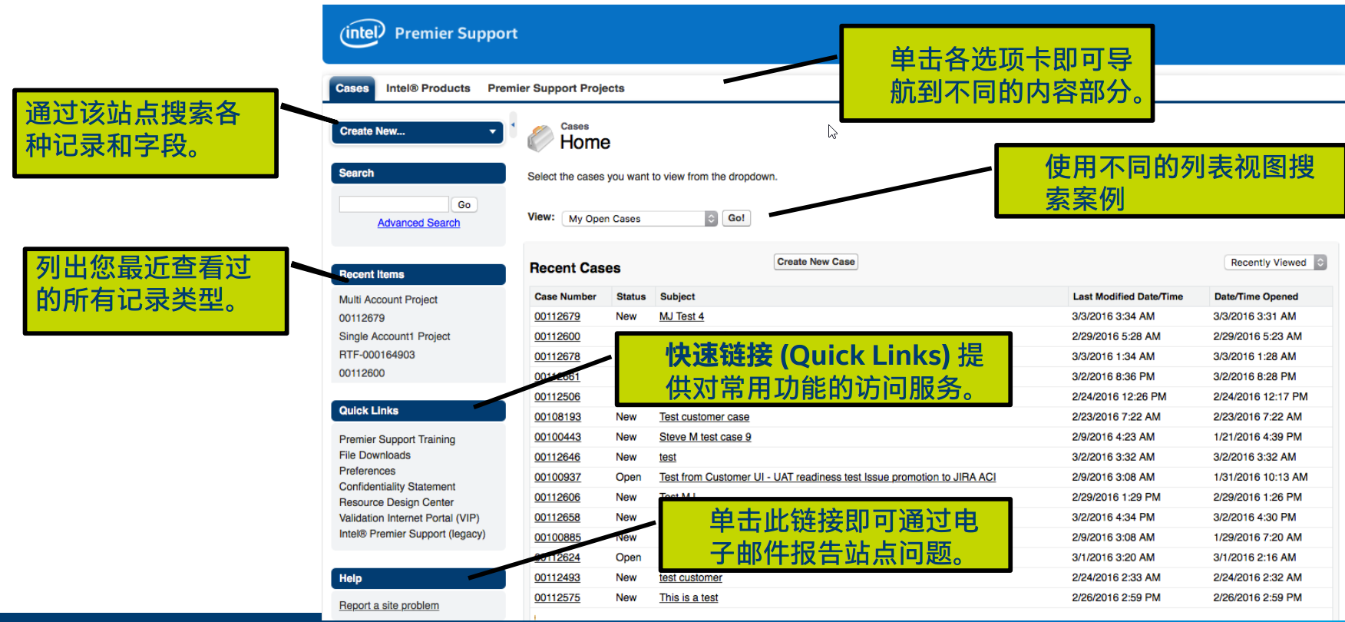
Intel Premier Support (IPS) Standard Service Level Plans for technical Issues

Slide 14

Customer Support Model
1st Line Support
2nd Line Support
Backend Support
Tech Lead
Engineering team:
HW design
SW development
IC design
etc
Customer
IPS
FAE
Architecture
Sales
SW AE
Mkt
HW AE
Dedicated PM, Architecture , SW and HW AE assigned
Weekly/biweekly meeting is conducted to track all opening issues

Slide 15
Harman/GWM Support Team
Name | Role | Contact info
Heng Zhang | Sales | Call Work: +86(021) 2207 1649 Mobile: +86 18616980507
 |  | Email: heng.zhang@intel.com
Alex Ni | FAE | Call Work: +86(021) 22071523 Mobile: +86 18101891923
 |  | Email: yiming.ni@intel.com
Chang Tommy | Tech Lead | Call Work: +86(021) 6116 4191Mobile: +86 136 3655 7112
 |  | Email: tommy.chang@intel.com
Jack Chen | HW AE | Call Work: +86(021) 6116 5499 Mobile: +86 158 6267 5543
 |  | Email: jie.jack.chen@intel.com
Max Zhou | SW AE | Call Work: +86(021) 61167395 Mobile: +86 137 6441 8706
 |  | Email: jingyu.zhou@intel.com
Jessica Du | AE Manager | Call Work: +86(021) 6116 6501 Mobile: +86 135 2464 5390
 |  | Email: jessica.du@intel.com
Paul Zhang | Architecture | Call Work: +86 (21) 6116 5761 Mobile: +86 138 6255 2478
 |  | Email: paul.zhang@intel.com
Grace Zhang | BD Manager | Call Work: +86(021) 6116 5532 Mobile: +86 186 1621 0101
 |  | Email: grace.h.zhang@intel.com

Slide 16
Move Forward
Intel Gives | Harman Gives
Platform introduction seminar – program schedule exchange, gaps identified System architecture design consultant/review Standard Linux Yocto BSP drops on MRB board. BSP customization and middleware/application development needs to be done by customers Schematic and layout reviews Design-in support by IPS system | Share project milestone/schedule Share HW system block diagram, product feature plans, use cases, so Intel can identify gaps Provides systems for issue debugging purpose, could need more systems to ship to different countries for different functions. All issues (sightings) need to be filed into IPS.

Slide 17
Backup

